Slide 1
Pillars and goals

Slide 2
CTP ENERGY - NEW Revenue stream
CTP TENANTS
SOLARS, WIND TURBINES
EXT. MARKET
LOCAL COMMUNITY
CHARGING STATIONS
CTP
ENERGY
COMMUNITY
STORAGE
ENERGY MANAGEMENT
SW TOOLS
TRADING
PEOPLE
VISION: CTP owns and operates whole Energy value chain generating additional revenues

Slide 3
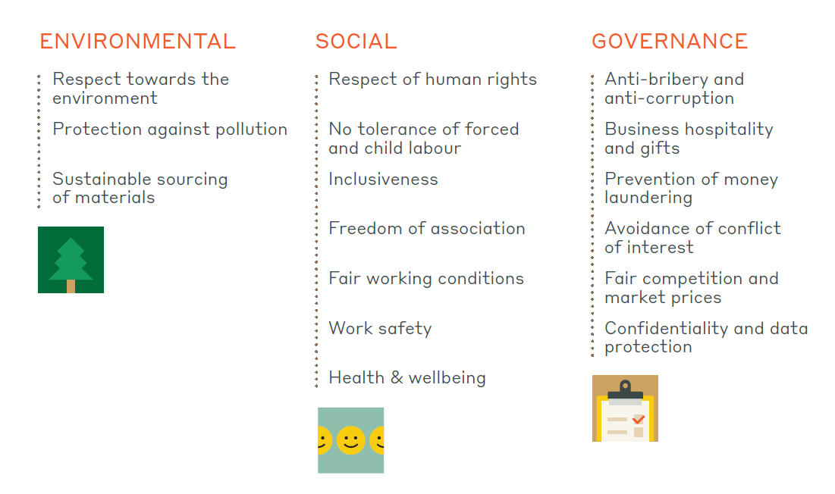
ESG areas covered (Suppliers' Code of Conduct)

